Slide 1

RETAIL & MARKETING ANALYTICS

Slide 2

Overview
■ Weꢀ haveꢀ optedꢀ toꢀ workꢀ onꢀ theꢀ Retailꢀ &ꢀ Marketingꢀ Analyticsꢀ domainꢀ usingꢀ
GlobalꢀSuperstoreꢀDataset.ꢀGlobalꢀSuperstoreꢀisꢀaꢀNewꢀYork-basedꢀglobalꢀonlineꢀ
retailerꢀ withꢀ aꢀ largeꢀ productꢀ inventoryꢀ andꢀ theꢀ goalꢀ ofꢀ beingꢀ aꢀ one-stopꢀ shopꢀ
forꢀitsꢀconsumers.
■ Retailꢀ analyticsꢀ isꢀ theꢀ practiceꢀ ofꢀ analyzingꢀ businessꢀ trends,ꢀ patterns,ꢀ andꢀ
performanceꢀinꢀtheꢀretailꢀindustryꢀusingꢀanalyticalꢀmethods.
■ Fromꢀ salesꢀ &ꢀ marketingꢀ toꢀ supplyꢀ chain,ꢀ inventory,ꢀandꢀ consumerꢀ behavior,ꢀ
retailꢀanalyticsꢀmayꢀprovideꢀactionableꢀinsightꢀtoꢀpositivelyꢀaffectꢀeveryꢀareaꢀofꢀ
theꢀretailꢀorganization.

Slide 3
Business Problem
■ TheꢀGlobalꢀSuperstoreꢀdatasetꢀcontainsꢀdataꢀonꢀorderꢀdetailsꢀofꢀcustomersꢀforꢀ
ordersꢀ fromꢀ theꢀ superstoreꢀ .ꢀ Thisꢀ includesꢀ theꢀ profit,ꢀ salesꢀ revenue,ꢀ state,ꢀ
region,ꢀorderꢀdate,ꢀshippingꢀdate,ꢀproductꢀorderedꢀetc.
■ Anꢀ analysisꢀ ofꢀ dataꢀ fromꢀ differentꢀ customersꢀ usingꢀ ourꢀ previousꢀ recordsꢀ willꢀ
helpꢀ usꢀ understandꢀ theꢀ pastꢀ salesꢀ transactionsꢀ recordsꢀ ofꢀ theꢀ companyꢀꢀ inꢀ aꢀ
broaderꢀ wayꢀ andꢀ makeꢀ amendsꢀ toꢀ improveꢀ theꢀ revenueꢀ ofꢀ theꢀ organizationꢀ
andꢀenhanceꢀtheꢀcustomerꢀexperience.
■ Useꢀcases:
– SalesꢀForecasting
– CustomerꢀSegmentation

Slide 4
Business Objective
■ Theꢀ Globalꢀ Superstoreꢀꢀprojectꢀ willꢀ giveꢀ usꢀ anꢀ ideaꢀ aboutꢀ howꢀ realꢀ businessꢀ
problemsꢀareꢀsolvedꢀusingꢀEDAꢀandꢀMachineꢀLearning.
■ Inꢀ thisꢀ project,ꢀ weꢀ willꢀ alsoꢀ developꢀ anꢀ understandingꢀ ofꢀ salesꢀ analyticsꢀ inꢀ
retailꢀ andꢀ marketingꢀservicesꢀ andꢀ understandꢀ howꢀ dataꢀ isꢀ usedꢀ toꢀ maximizeꢀ
theꢀrevenueꢀofꢀtheꢀcompany.

Slide 5
Dataset Description
§ TheꢀGlobalꢀSuperstoreꢀdatasetꢀcontainsꢀaroundꢀ51k+ꢀvalues,ꢀandꢀ24ꢀfeatures.ꢀ
It’sꢀ aꢀ customerꢀ centricꢀ dataꢀ set,ꢀ whichꢀ hasꢀ theꢀ dataꢀ ofꢀ allꢀ theꢀ ordersꢀ thatꢀ
haveꢀbeenꢀplacedꢀthroughꢀdifferentꢀvendorsꢀandꢀmarkets,ꢀstartingꢀfromꢀtheꢀ
yearꢀ2012ꢀtillꢀ2015.
Source- https://data.world/asepetruk/global-superstore

Slide 6

Variable Name
RowꢀId
Variable Description
Data Type
Numerical
Categorical
Data Type
Categorical
Numerical
Datetime
Variable Count
SerialꢀNumbers
OrderꢀId
IDꢀcreatedꢀwhenꢀaꢀproductꢀorderꢀisꢀplaced.
15
7
OrderꢀDate
ShipꢀDate
ShipꢀMode
Dateꢀonꢀwhichꢀaꢀcustomerꢀplacesꢀhis/herꢀorder.
Dateꢀonꢀwhichꢀtheꢀorderꢀisꢀshipped.
Modeꢀofꢀshipmentꢀofꢀeachꢀorder.
Datetime
Datetime
Categorical
2
CustomerꢀId
IDꢀassignedꢀtoꢀeachꢀcustomerꢀwhoꢀplacesꢀanꢀorder.
NameꢀofꢀCustomer.
Categorical
Categorical
CustomerꢀName
Segment
PostalꢀCode
City
Sectionꢀfromꢀwhereꢀtheꢀorderꢀisꢀplaced.
PinꢀCode
Categorical
Numerical
Categorical
Customer’sꢀCity
State
StateꢀwhereꢀCustomer’sꢀCityꢀisꢀLocated
CountryꢀwhereꢀStateꢀisꢀLocated
Countriesꢀgroupedꢀregionꢀwise
GlobalꢀRegions
Categorical
Categorical
Categorical
Categorical
Categorical
Categorical
Categorical
Categorical
Country
Region
Market
ProductꢀId
Category
Sub-Category
ProductꢀName
ProductꢀIDꢀofꢀeachꢀproduct
Categoryꢀtoꢀwhichꢀeachꢀproductꢀbelongsꢀto.
Sub-CategoryꢀofꢀeachꢀCategory
Nameꢀofꢀproducts.
Sales
RevenueꢀGeneratedꢀonꢀProductꢀSales.
Numberꢀofꢀproductsꢀsoldꢀinꢀtheꢀorder.
Discountꢀavailableꢀonꢀeachꢀproduct.
Profitꢀgainedꢀonꢀsales.
Numerical
Numerical
Numerical
Numerical
Numerical
Quantity
Discount
Profit
ShippingꢀCost
Amountꢀpayableꢀforꢀshipping.
OrderꢀPriority
PriorityꢀofꢀtheꢀOrders
Categorical

Slide 7
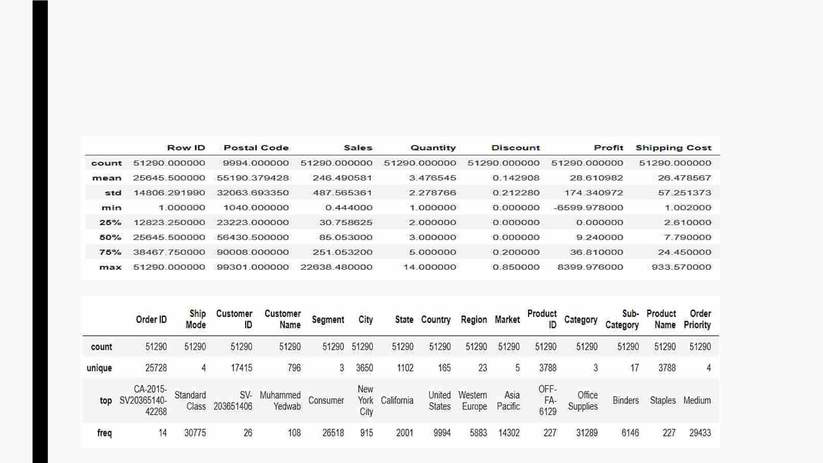
EDA & Statistical Analysis
§ StatisticalꢀSummaryꢀforꢀNumericalꢀandꢀCategoricalꢀvariables

Slide 8
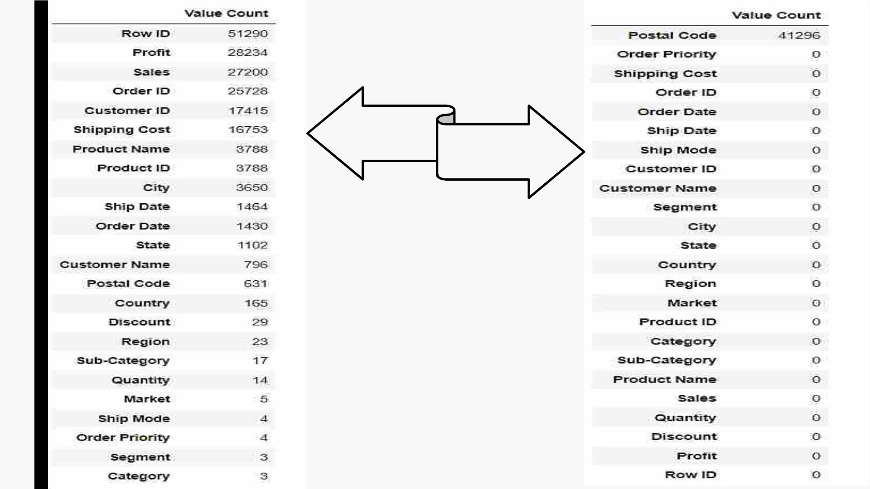
No. of Unique
Values
No. of Null
Values

Slide 9
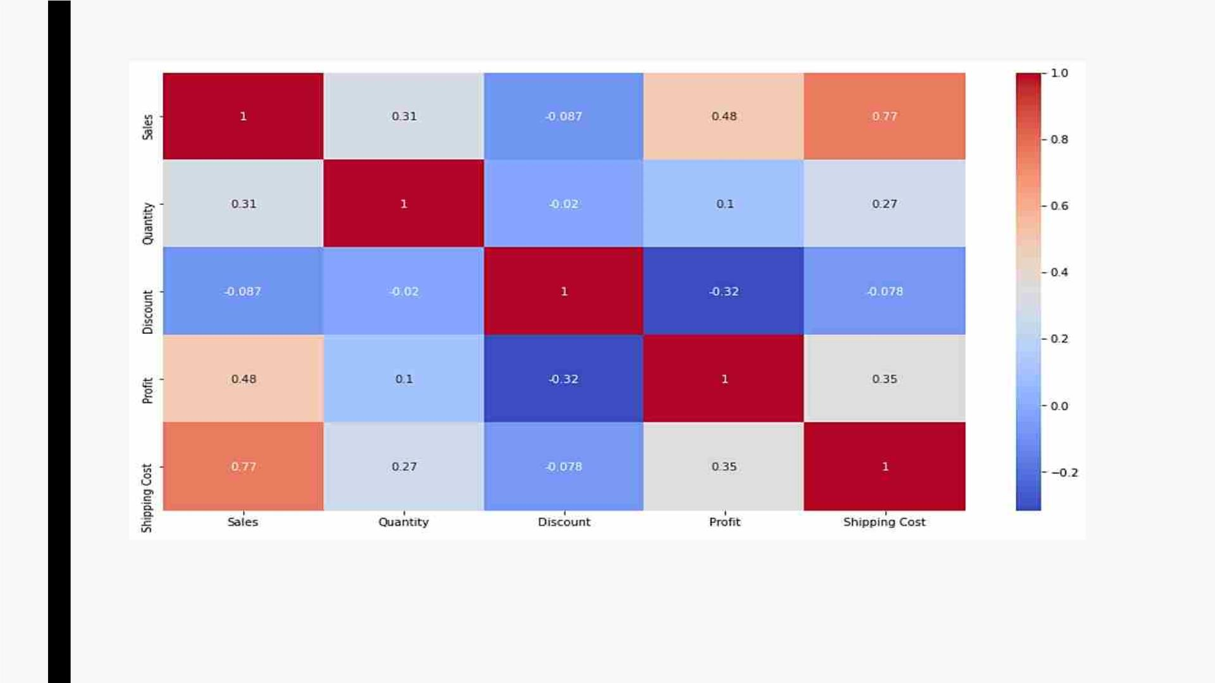
Correlation Matrix
§ SalesꢀhasꢀhighestꢀcorrelationꢀwithꢀShippingꢀCost,ꢀandꢀmoderateꢀcorrelationꢀwithꢀ
Quantity.
§ ProfitꢀisꢀalsoꢀmoderatelyꢀcorrelatedꢀwithꢀSales.

Slide 10
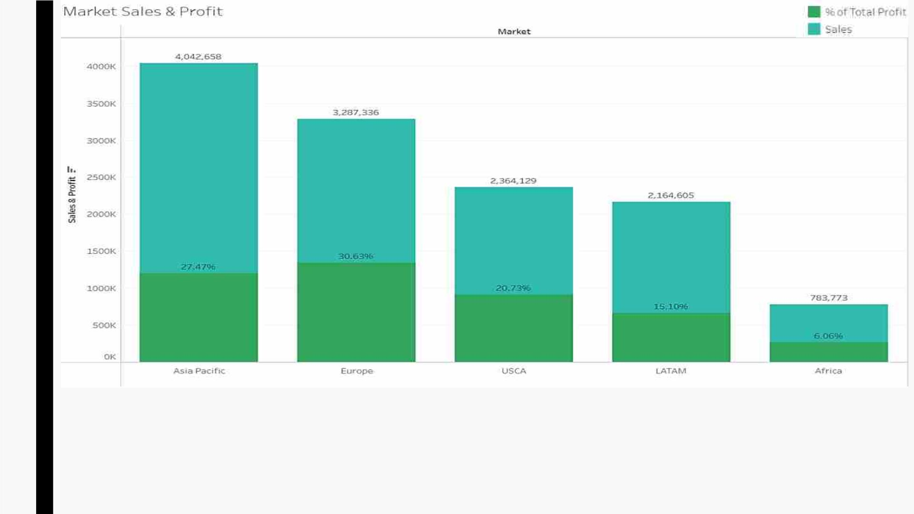
§ AsiaꢀPacificꢀisꢀtheꢀhighestꢀrevenueꢀgeneratingꢀmarket,ꢀwhereas,ꢀEuropeꢀisꢀhighestꢀProfitꢀ
makingꢀmarket.

Slide 11
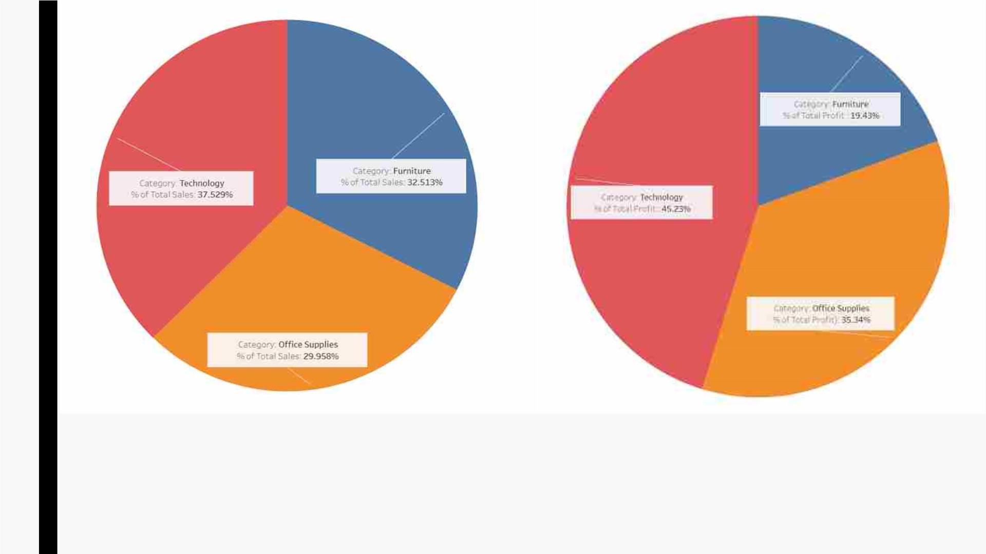
§ Inꢀcaseꢀofꢀboth,ꢀOverallꢀSalesꢀandꢀOverallꢀProfit,ꢀshareꢀofꢀTechnologyꢀisꢀhighest.
§ Furnitureꢀbeingꢀ2ndꢀhighestꢀshareholderꢀinꢀOverallꢀSales,ꢀitsꢀProfitꢀshareꢀisꢀtheꢀlowest.

Slide 12
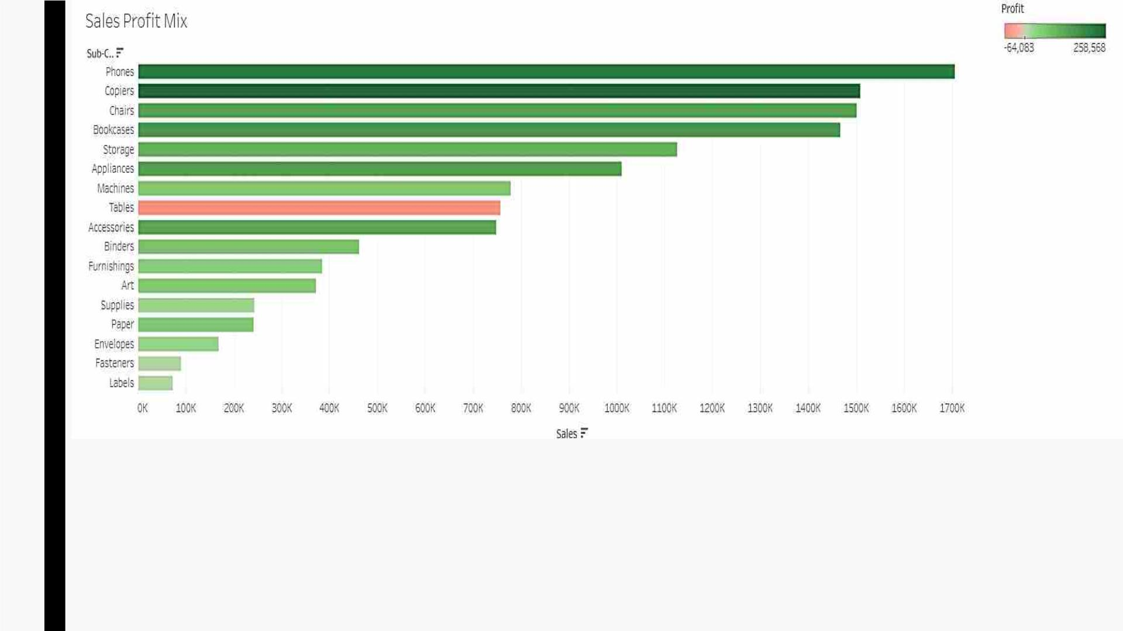
§ Amongstꢀ allꢀ theꢀ sub-categories,ꢀ Phonesꢀ areꢀ generatingꢀ highestꢀ revenueꢀ forꢀ theꢀ
superstore.
§ Inꢀtermsꢀofꢀprofit,ꢀCopiersꢀmakeꢀhighestꢀprofit
§ Tablesꢀareꢀtheꢀonlyꢀlossꢀmakingꢀsub-category.

Slide 13
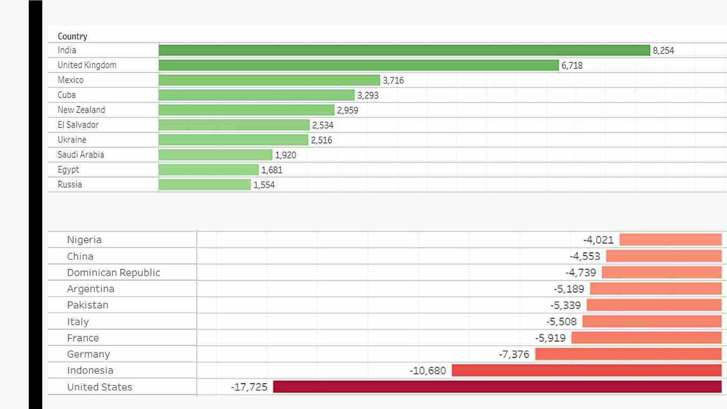
§ Topꢀ10ꢀcountries,ꢀwhereꢀ‘Tables’ꢀareꢀmakingꢀprofits.
§ Topꢀ10ꢀcountries,ꢀwhereꢀ‘Tables’ꢀareꢀmakingꢀloss.

Slide 14
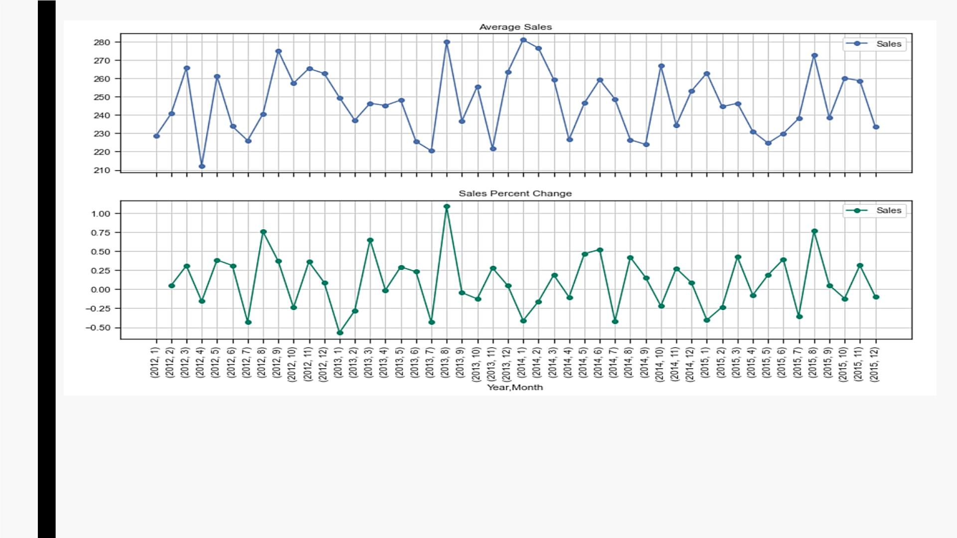
§ InꢀGraphꢀ1,ꢀAverageꢀSalesꢀofꢀeachꢀmonth,ꢀoverꢀtheꢀyears,ꢀcanꢀbeꢀobserved.
§ InꢀGraphꢀ2,ꢀPercentageꢀChangeꢀinꢀSalesꢀofꢀeachꢀmonth,ꢀoverꢀtheꢀyears,ꢀcanꢀbeꢀ
observed.

Slide 15
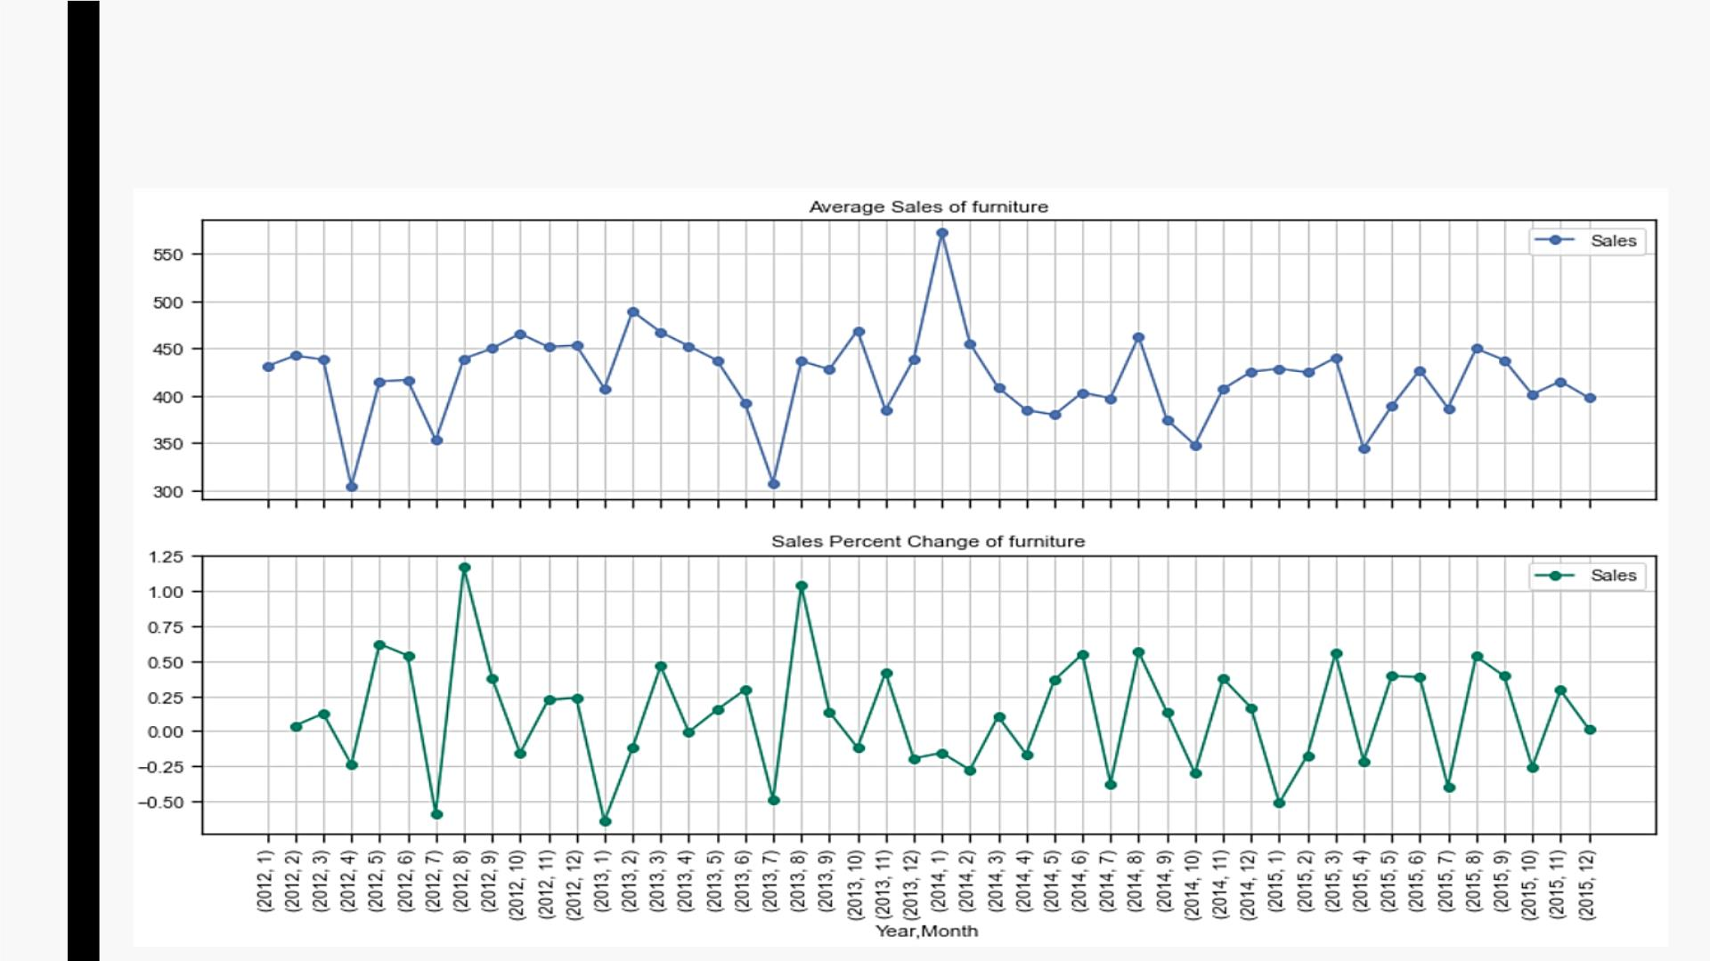
§ AverageꢀSalesꢀandꢀPercentageꢀChangeꢀinꢀSalesꢀofꢀeachꢀmonth,ꢀoverꢀtheꢀyears,ꢀforꢀ
Furnitureꢀcategory.

Slide 16
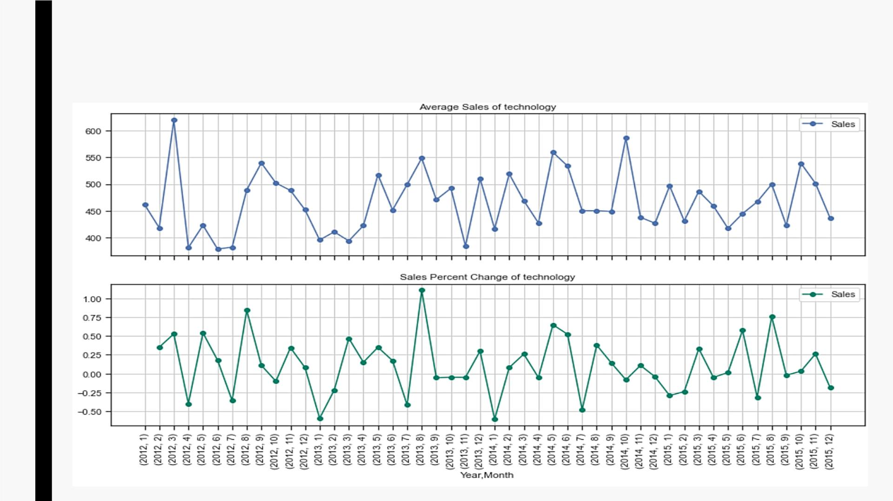
§ AverageꢀSalesꢀandꢀPercentageꢀChangeꢀinꢀSalesꢀofꢀeachꢀmonth,ꢀoverꢀtheꢀyears,ꢀforꢀ
Technologyꢀcategory.

Slide 17
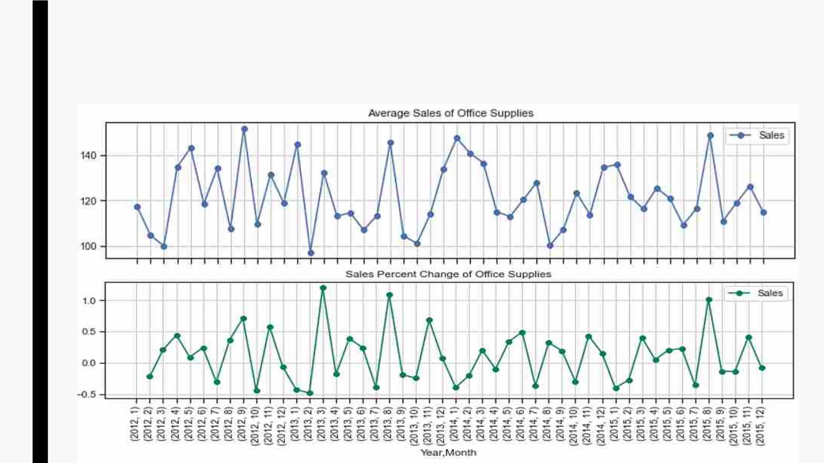
§ AverageꢀSalesꢀandꢀPercentageꢀChangeꢀinꢀSalesꢀofꢀeachꢀmonth,ꢀoverꢀtheꢀyears,ꢀforꢀ
OfficeꢀSuppliesꢀcategory.

Slide 18
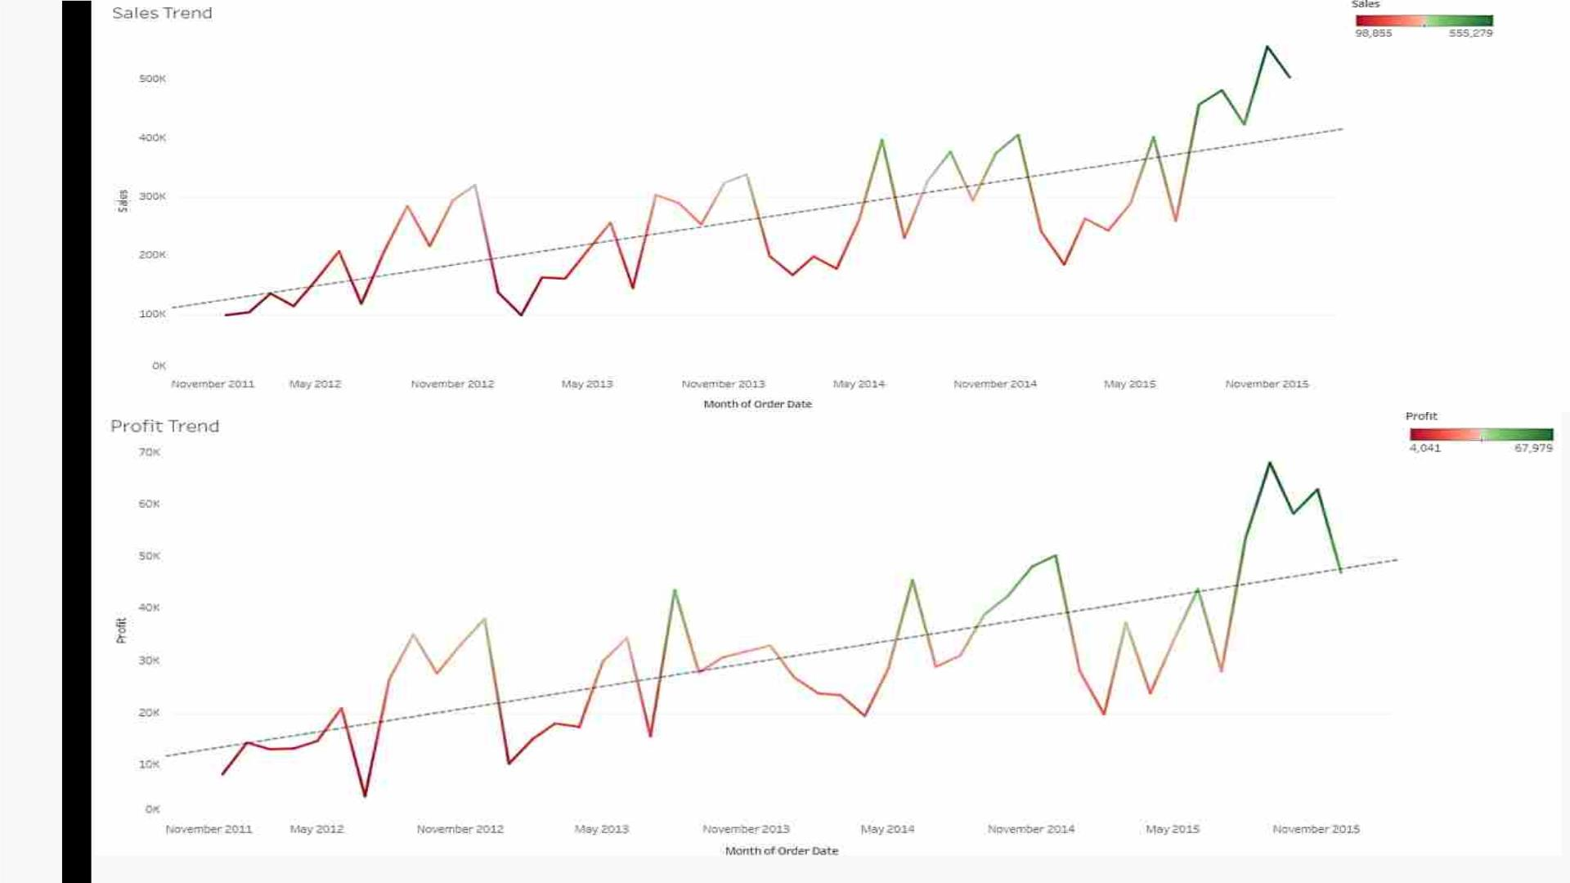

Slide 19

Customer Segmentation - RFM
RFM Analysis
■ RFMꢀ(Recency,ꢀFrequency,ꢀMonetary)ꢀanalysisꢀisꢀaꢀcustomerꢀsegmentationꢀ
techniqueꢀthatꢀusesꢀpastꢀpurchaseꢀbehaviorꢀtoꢀdivideꢀcustomersꢀintoꢀ
groups.
■ RFMꢀhelpsꢀdivideꢀcustomersꢀintoꢀvariousꢀcategoriesꢀorꢀclustersꢀtoꢀidentifyꢀ
customersꢀwhoꢀareꢀmoreꢀlikelyꢀtoꢀrespondꢀtoꢀpromotionsꢀandꢀalsoꢀforꢀ
futureꢀpersonalizationꢀservices.
§ RECENCYꢀ(R):ꢀDaysꢀsinceꢀlastꢀpurchase
§ FREQUENCYꢀ(F):ꢀTotalꢀnumberꢀofꢀpurchases
§ MONETARYꢀVALUEꢀ(M):ꢀTotalꢀmoneyꢀthisꢀcustomerꢀspent.
Weꢀwillꢀcreateꢀthoseꢀ3ꢀcustomerꢀattributesꢀfromꢀoriginalꢀdataset,ꢀforꢀeachꢀ
customer.

Slide 20
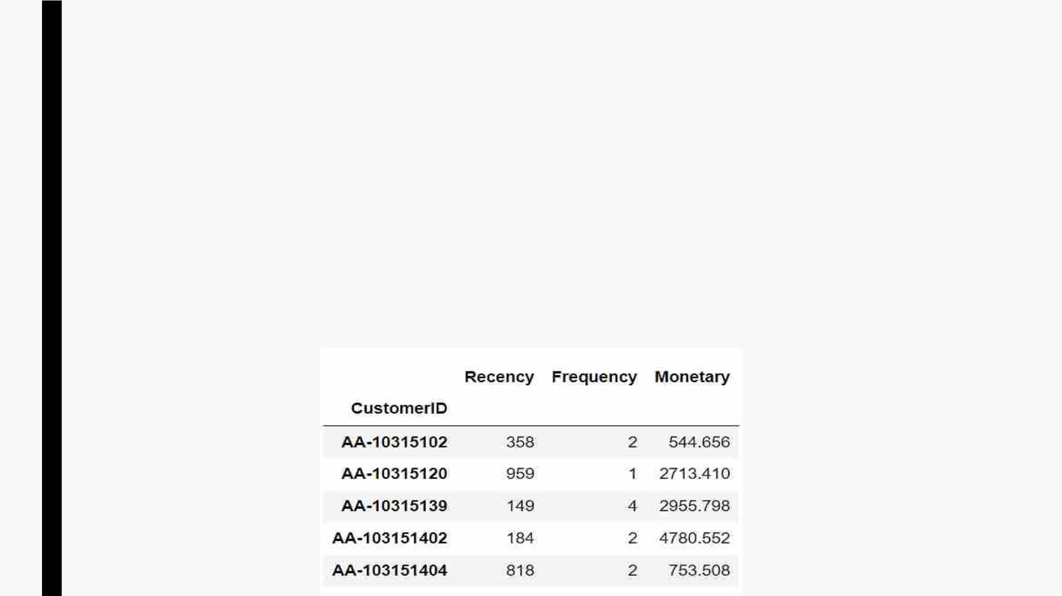
Applying RFM
■ CompleteꢀdataꢀisꢀgroupedꢀbyꢀCustomerID.
■ RecencyꢀisꢀcalculatedꢀasꢀdifferenceꢀofꢀdaysꢀfromꢀmaxꢀofꢀOrderꢀDateꢀandꢀ
lastꢀOrderꢀDateꢀofꢀrespectiveꢀcustomer.
■ FrequencyꢀisꢀcalculatedꢀasꢀcountꢀofꢀuniqueꢀOrderIDꢀofꢀrespectiveꢀ
customer.
■ Monetaryꢀisꢀcalculatedꢀasꢀanꢀamount,ꢀaꢀcustomerꢀhasꢀspentꢀoverꢀtime.

Slide 21
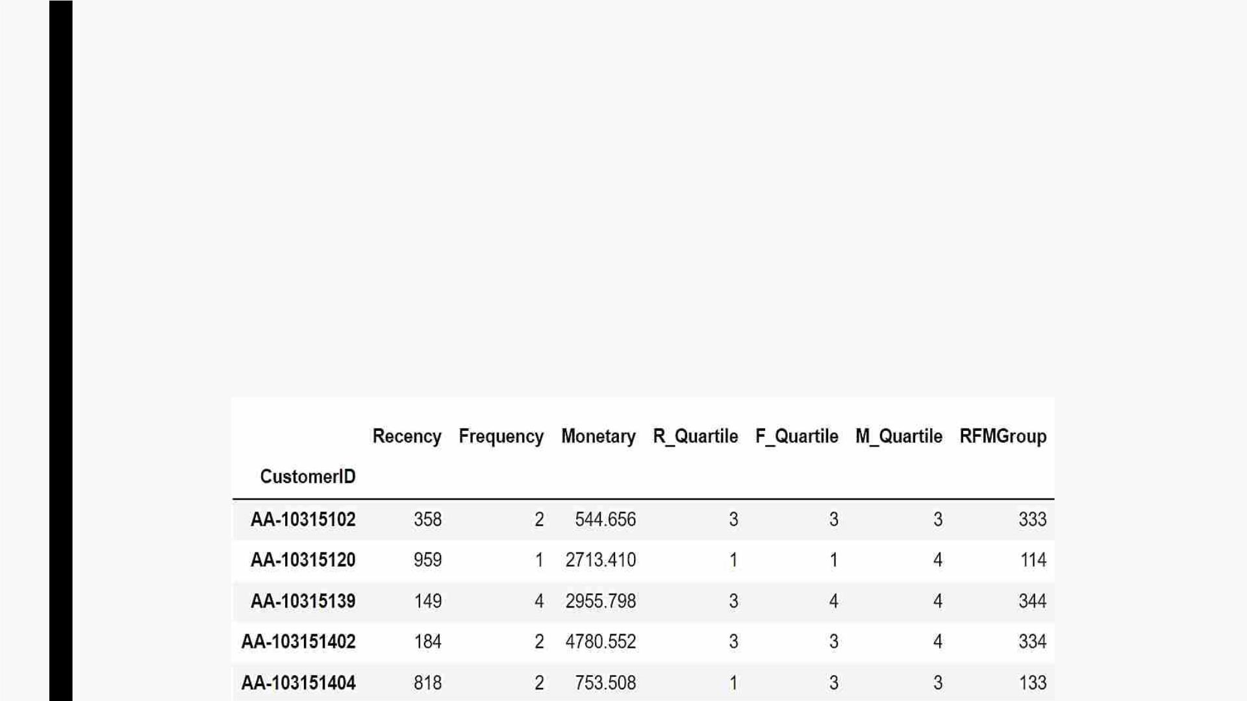
Applying RFM score formula
■ TheꢀsimplestꢀwayꢀtoꢀcreateꢀcustomersꢀsegmentsꢀfromꢀRFMꢀModelꢀisꢀtoꢀuseꢀQuartiles.ꢀ
Weꢀassignꢀaꢀscoreꢀfromꢀ1ꢀtoꢀ4ꢀtoꢀRecency,ꢀFrequencyꢀandꢀMonetary.
■ ꢀFourꢀisꢀtheꢀbest/highestꢀvalue,ꢀandꢀoneꢀisꢀtheꢀlowest/worstꢀvalue.ꢀ
■ AꢀRFMꢀGroupꢀisꢀcalculatedꢀsimplyꢀbyꢀconcatenatingꢀindividualꢀRFMꢀQuartileꢀnumbers.
■ Totalꢀofꢀ64ꢀGroupsꢀareꢀcreated.

Slide 22
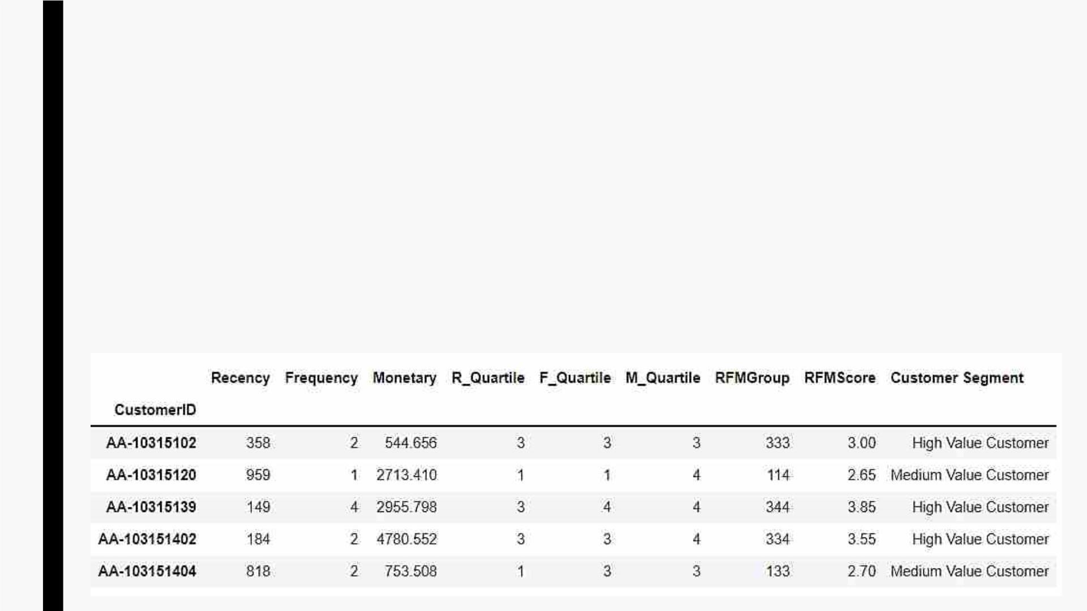
■ FinalꢀRFMScoreꢀisꢀcalculatedꢀbyꢀassigningꢀweightsꢀtoꢀindividualꢀRFMꢀQuartileꢀValues,ꢀ
andꢀaddingꢀthem.
– 0.15*Rꢀ+ꢀ0.30*Fꢀ+ꢀ0.55*M
– Belowꢀ50ꢀpercentileꢀofꢀRFMScoreꢀisꢀLowꢀValueꢀCustomer
– Aboveꢀ50,ꢀbutꢀbelowꢀ75ꢀpercentileꢀofꢀRFMScoreꢀisꢀMediumꢀValueꢀCustomer
– Aboveꢀ75ꢀpercentileꢀofꢀRFMScoreꢀisꢀHighꢀValueꢀCustomer
■ RangeꢀofꢀRFMScoreꢀisꢀ1ꢀtoꢀ4.
– 50ꢀpercentile=2.25
– 75ꢀpercentile=2.95

Slide 23
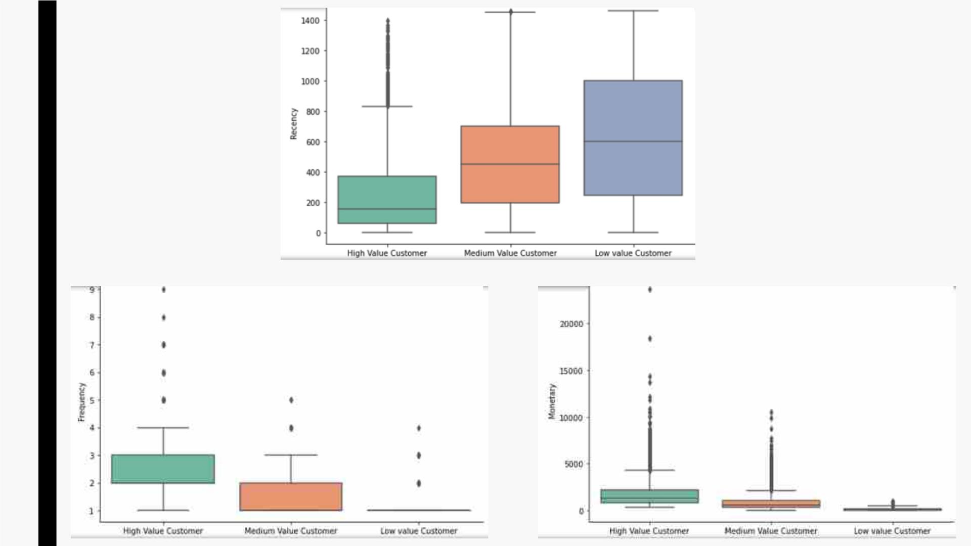

Slide 24
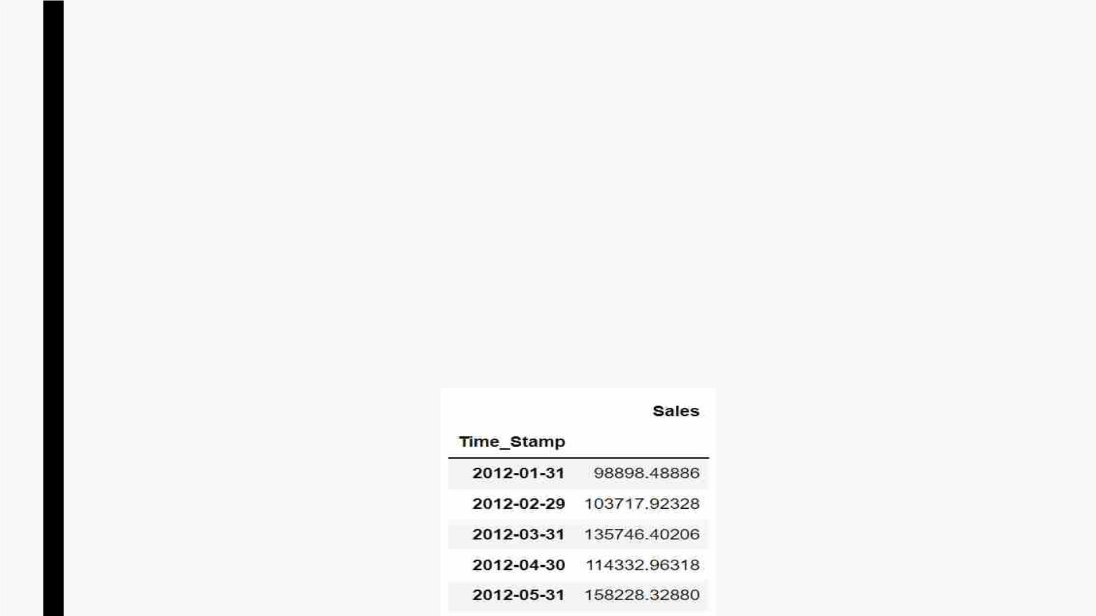
Data Pre-processing For Sales Forecasting
§ Selecting Relevant Data For Time Series
– OnlyꢀOrderꢀDateꢀandꢀSalesꢀcolumnsꢀareꢀextractedꢀfromꢀoriginalꢀdata.
§ Processing Data
– Extractingꢀ Yearꢀ andꢀ Monthꢀ asꢀ aꢀ separateꢀ columnsꢀ fromꢀ theꢀ sortedꢀ dataꢀ
usingꢀdatetimeꢀlibrary.
– Groupingꢀ theꢀ sortedꢀ dataꢀ w.r.tꢀYearꢀ andꢀ Monthꢀ columnsꢀ andꢀ calculatingꢀ
SumꢀofꢀSalesꢀforꢀeachꢀmonthꢀofꢀtheꢀyear.

Slide 25
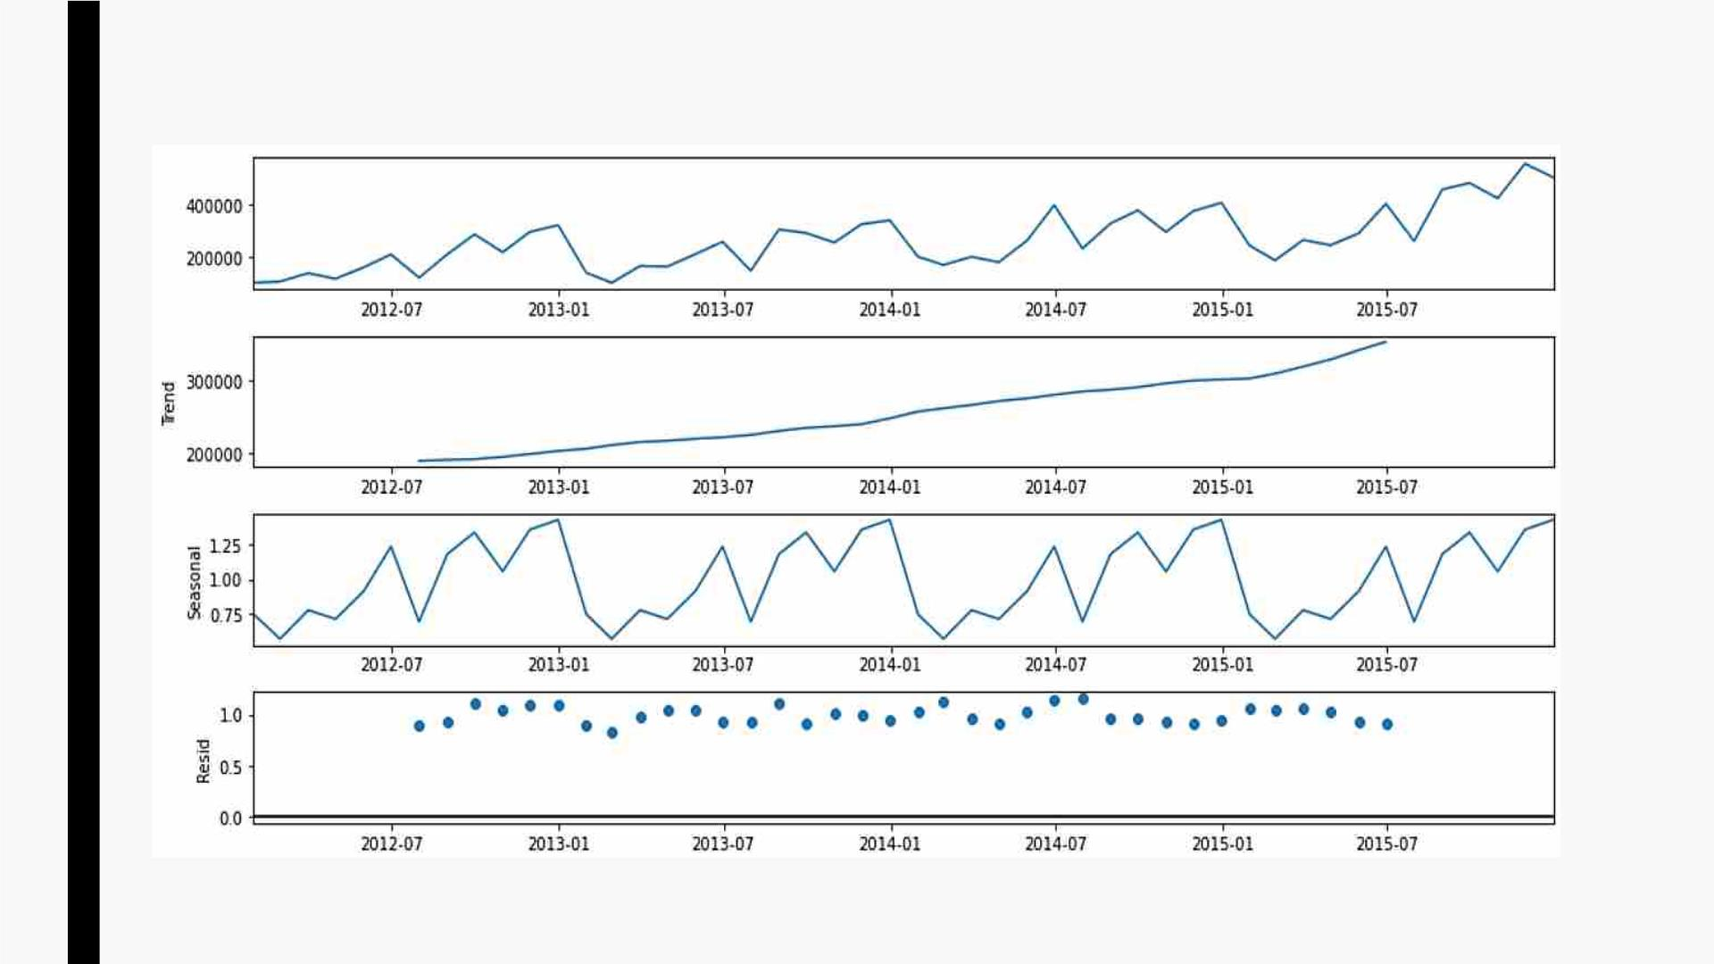
■ DecompositionꢀofꢀTimeꢀSeriesꢀData
-BreakingꢀdownꢀdataꢀintoꢀTrend,ꢀSeasonalityꢀandꢀirregularꢀcomponents.

Slide 26
■ TestingꢀforꢀStationarity
-ꢀPerformingꢀAugmentedꢀDickeyꢀFullerꢀTest:
• H0:ꢀTimeꢀSeriesꢀisꢀnotꢀStationary
• H1:ꢀTimeꢀSeriesꢀisꢀStationary
- Consideringꢀαꢀ=ꢀ0.05,ꢀtestingꢀwithꢀ95%ꢀconfidence:
• Ifꢀp-valueꢀ>ꢀα,ꢀweꢀfailꢀtoꢀrejectꢀH0
• Ifꢀp-valueꢀ<ꢀα,ꢀweꢀrejectꢀH0
§ Obtainedꢀp-value=ꢀ0.988
§ Asꢀp-valueꢀ>ꢀα,ꢀweꢀfailꢀtoꢀrejectꢀH0,henceꢀTimeꢀSeriesꢀDataꢀisꢀnotꢀStationary.
§ SinceꢀDataꢀisꢀnotꢀstationary,ꢀeitherꢀweꢀneedꢀtoꢀtransformꢀorꢀuseꢀdifferencingꢀtoꢀ
makeꢀitꢀstationary

Slide 27
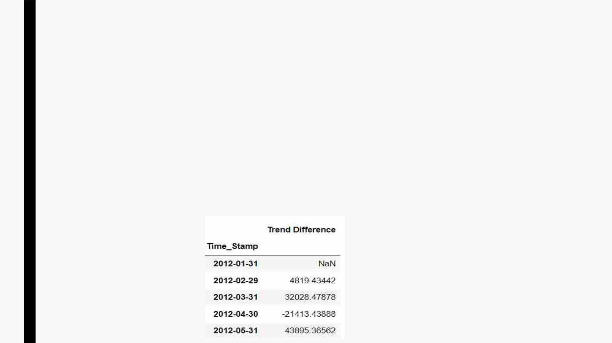
■ TryingꢀonꢀLogꢀTransformedꢀdata
– Obtainedꢀp-value=ꢀ0.952,ꢀFailꢀtoꢀrejectꢀH0
■ TryingꢀonꢀSquareꢀRootꢀTransformedꢀdata
– Obtainedꢀp-value=ꢀ0.976,ꢀFailꢀtoꢀrejectꢀH0
■ TryingꢀonꢀBoxꢀCoxꢀTransformedꢀdata
– Obtainedꢀp-value=ꢀ0.966,ꢀFailꢀtoꢀrejectꢀH0
■ TryingꢀonꢀTrendꢀDifferencedꢀdata(FirstꢀOrderꢀDifference)
– Obtainedꢀp-value=ꢀ-1.26e-13,ꢀrejectꢀH0,ꢀhenceꢀTrendꢀDifferencedꢀdataꢀisꢀStationary.

Slide 28
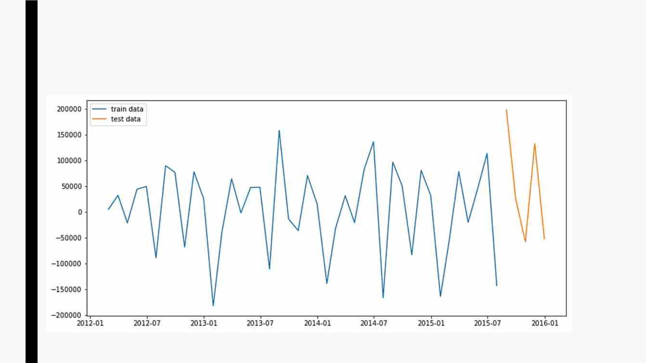
■ TrendꢀDifferenceꢀbeingꢀrelevantꢀdata,ꢀweꢀhaveꢀdivided:
– Firstꢀ42ꢀobservationsꢀofꢀtheꢀfinalꢀdataꢀintoꢀtrainꢀdata
– Lastꢀ5ꢀobservationꢀofꢀtheꢀfinalꢀdataꢀintoꢀtestꢀdata

Slide 29
Sales Forecasting- Time Series
■ Timeꢀ Seriesꢀ analysisꢀ isꢀ oneꢀ ofꢀ theꢀ coreꢀ skillsꢀ ofꢀ anyꢀ dataꢀ scientistꢀ andꢀ anyoneꢀ
workingꢀinꢀtheꢀanalyticsꢀfieldꢀoftenꢀcomesꢀacrossꢀtheꢀsituationꢀtoꢀforecastꢀtheꢀ
futureꢀprovidedꢀwithꢀtheꢀpastꢀandꢀpresentꢀdata.ꢀ
■ Aꢀseriesꢀofꢀobservationsꢀtakenꢀatꢀspecifiedꢀtimesꢀbasicallyꢀatꢀequalꢀintervals.ꢀItꢀ
isꢀusedꢀtoꢀpredictꢀfutureꢀvaluesꢀbasedꢀonꢀpastꢀobservedꢀvalues.
■ Inꢀtheꢀcaseꢀofꢀsuchꢀdatasetsꢀwhereꢀonlyꢀoneꢀvariableꢀisꢀobservedꢀatꢀeachꢀtimeꢀ
isꢀcalledꢀ‘UnivariateꢀTimeꢀSeries’.

Slide 30
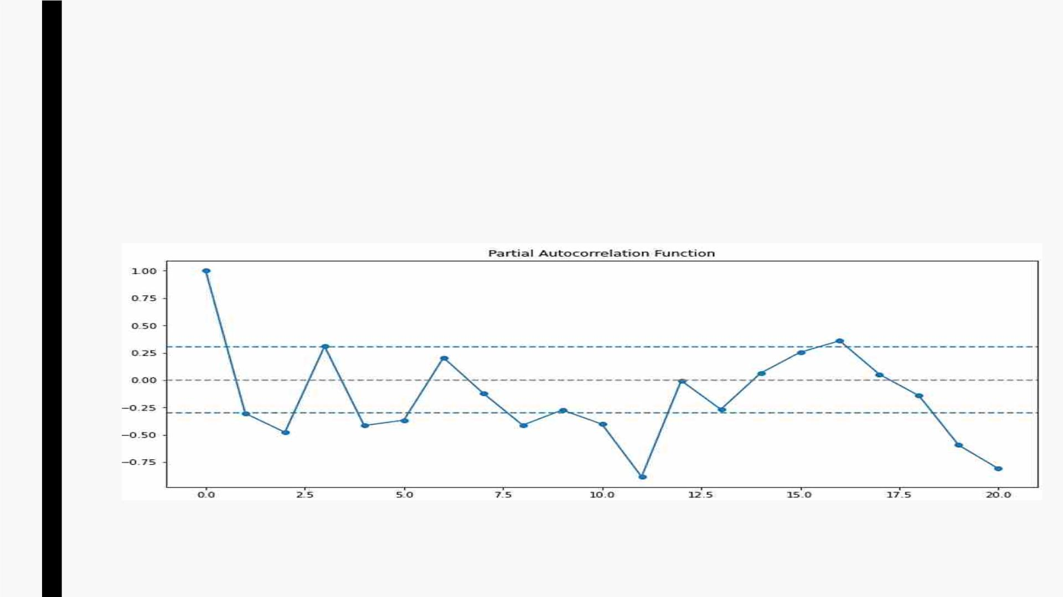
Building AR model
■ AR(AutoregressiveꢀModel)ꢀforecastsꢀonꢀtheꢀbasisꢀofꢀpastꢀobservations,ꢀandꢀitꢀtakesꢀ
parameterꢀp,ꢀwhichꢀisꢀdeterminedꢀthroughꢀpacf(partialꢀautocorrelationꢀfunction).
■ Optimalꢀvalueꢀofꢀpꢀisꢀobtainedꢀwhenꢀtheꢀvalueꢀcrossesꢀupperꢀconfidenceꢀintervalꢀforꢀ
theꢀfirstꢀtime.
■ Inꢀtheꢀaboveꢀplot,ꢀoptimalꢀvalueꢀofꢀpꢀisꢀ1.

Slide 31
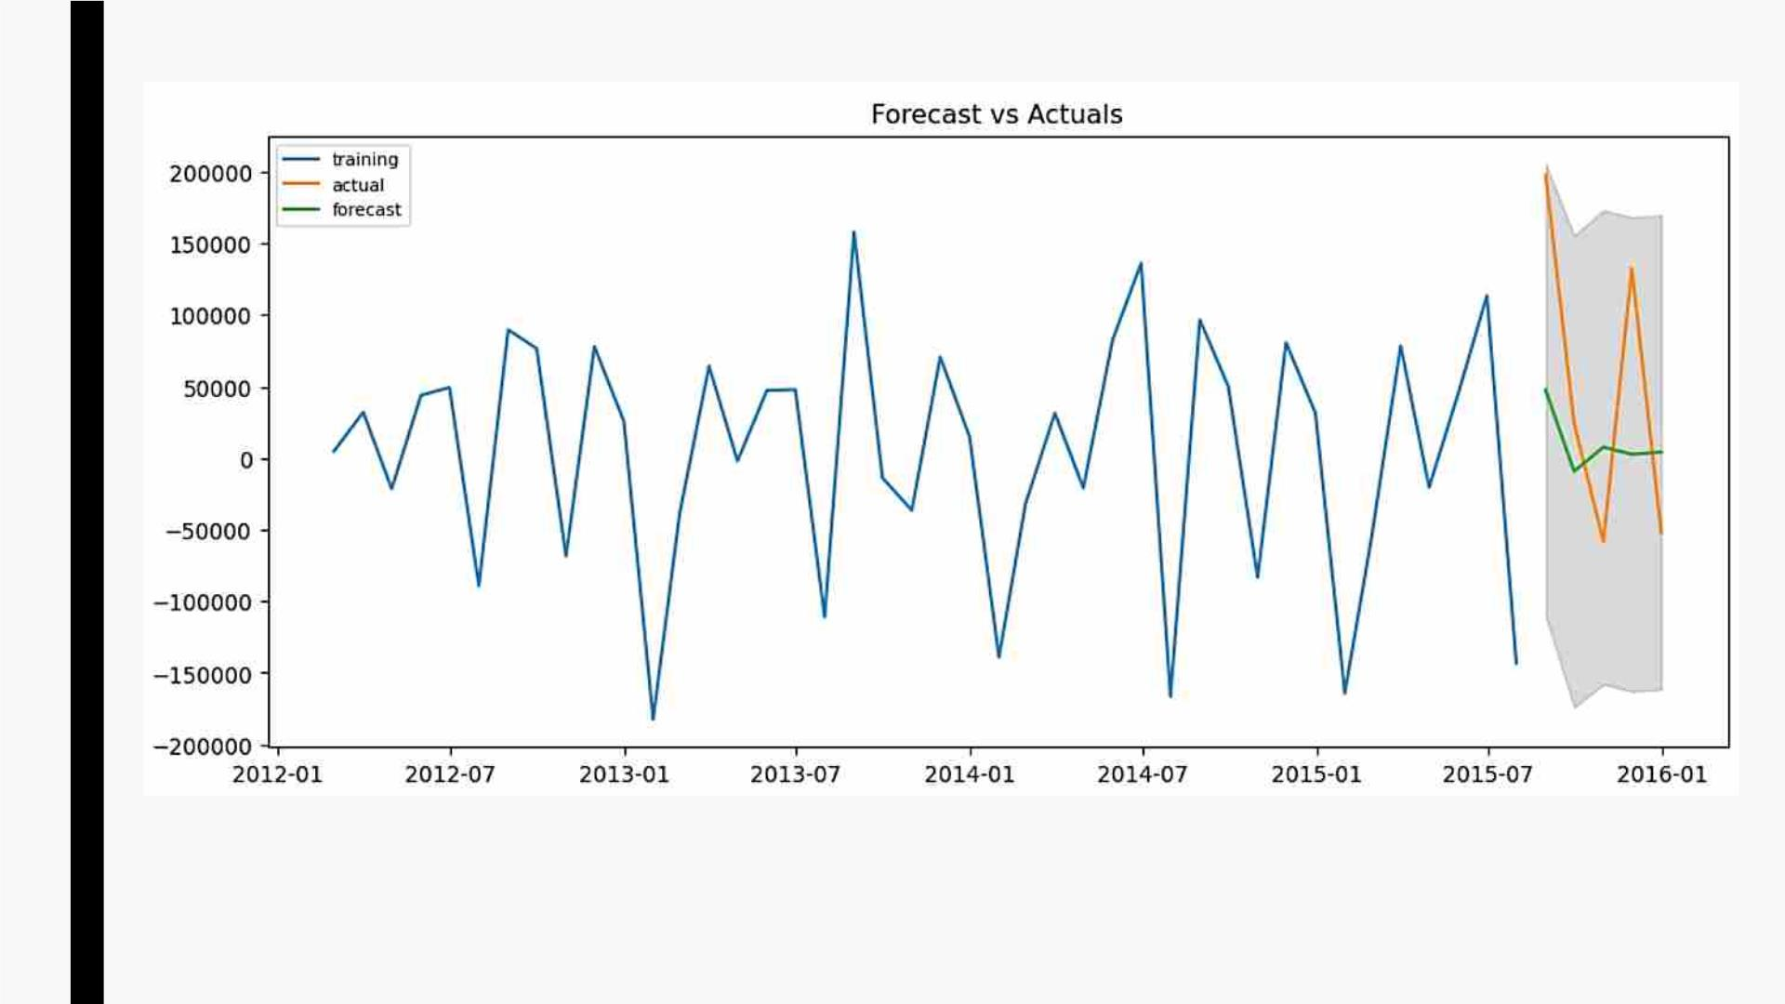
■ PlottingꢀActualꢀandꢀForecastedꢀvaluesꢀwithꢀ95%ꢀconfidenceꢀinterval
■ MAPE(MeanꢀAbsoluteꢀPercentageꢀError)=1.06

Slide 32
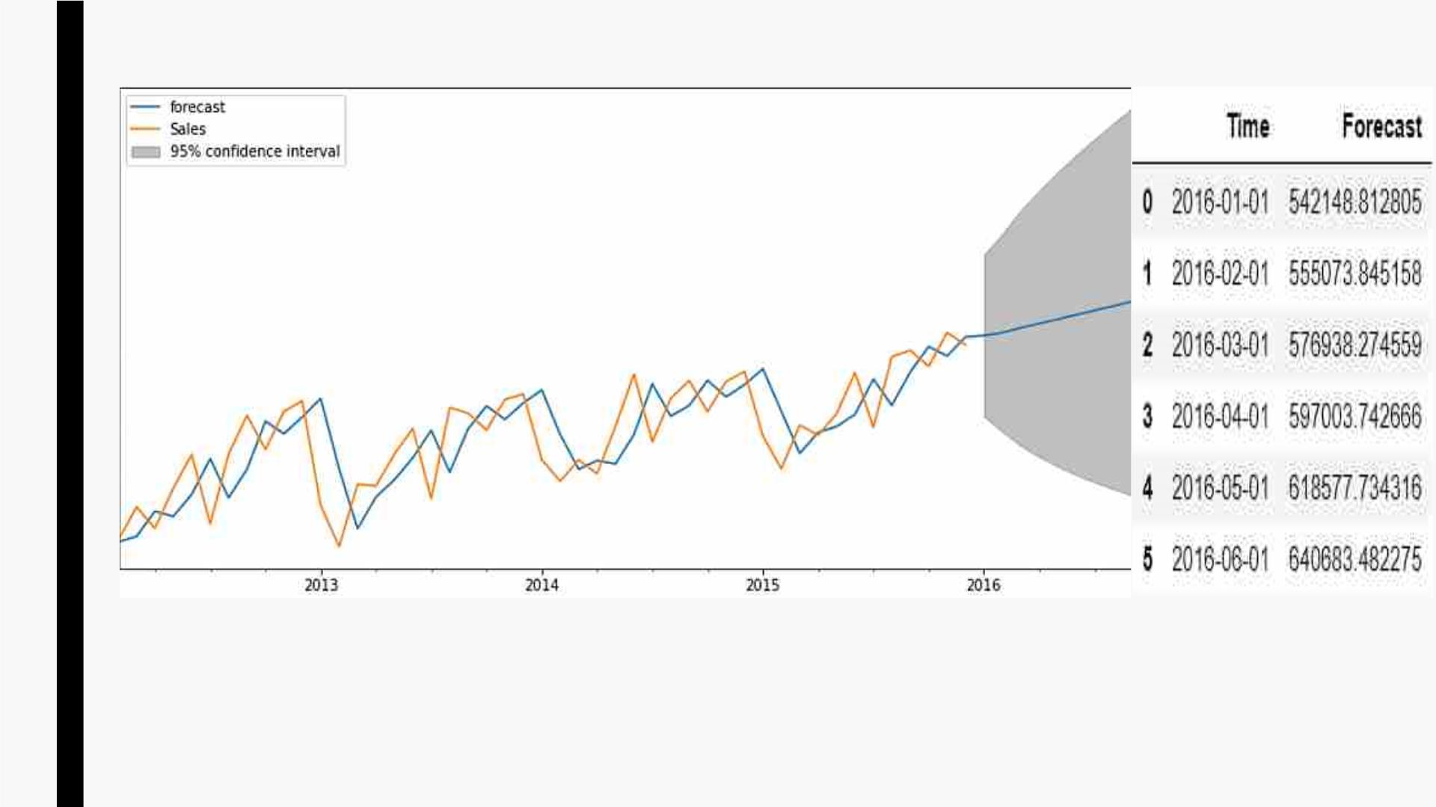
■ PlottingꢀvaluesꢀinꢀOriginalꢀScaleꢀandꢀForecastingꢀforꢀnextꢀ6ꢀmonthsꢀwithꢀARꢀModel

Slide 33
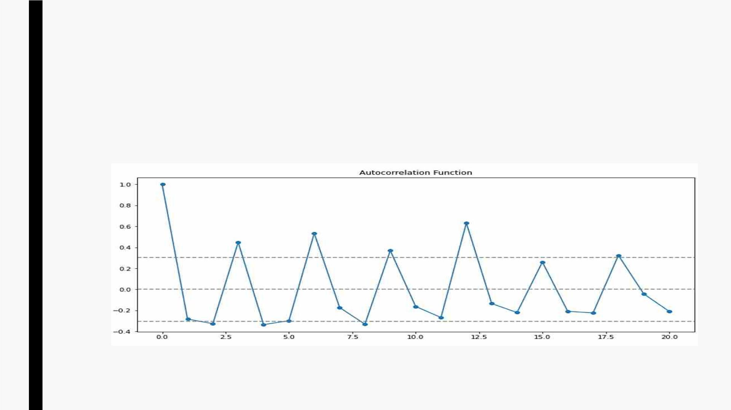
Building MA model
■ MA(MovingꢀAverage)ꢀusesꢀpastꢀforecastedꢀerror,ꢀandꢀtakesꢀparameterꢀq,ꢀwhichꢀisꢀ
determinedꢀusingꢀacf(autocorrelationꢀfunction).
■ Optimalꢀvalueꢀofꢀqꢀisꢀobtainedꢀwhenꢀtheꢀvalueꢀcrossesꢀupperꢀconfidenceꢀintervalꢀforꢀ
theꢀfirstꢀtime.
■ Inꢀtheꢀaboveꢀplot,ꢀoptimalꢀvalueꢀofꢀqꢀisꢀ1.

Slide 34
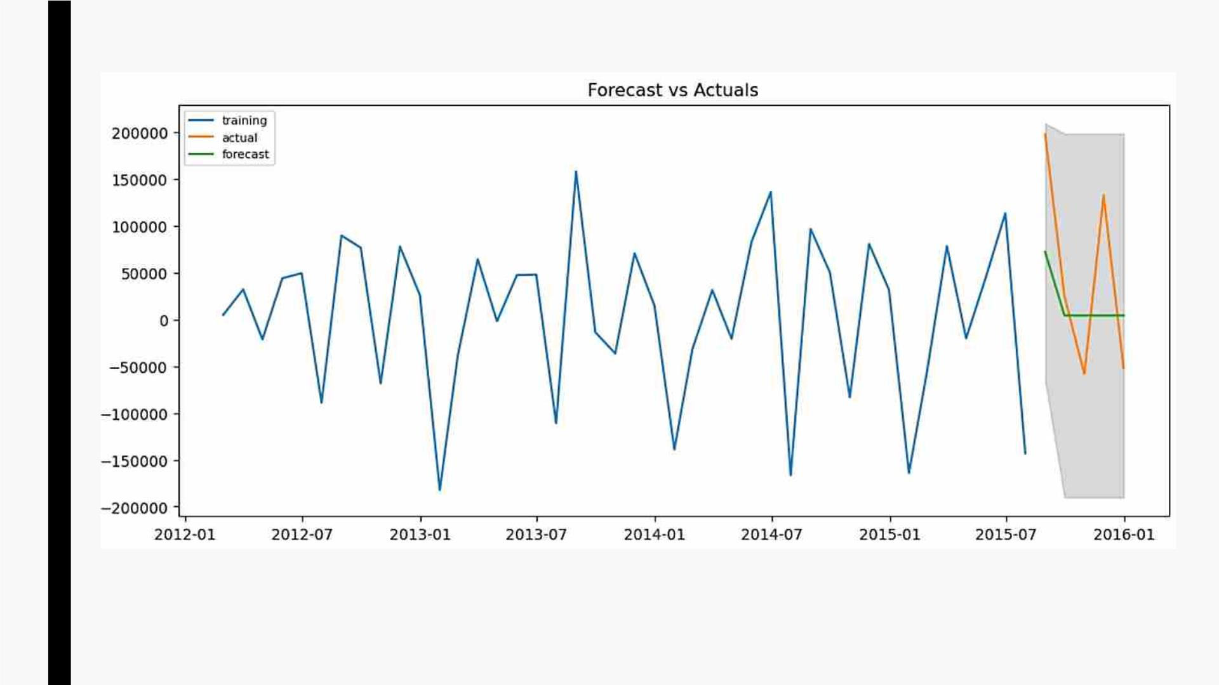
■ PlottingꢀActualꢀandꢀForecastedꢀvaluesꢀwithꢀ95%ꢀconfidenceꢀinterval.
■ MAPE(MeanꢀAbsoluteꢀPercentageꢀError)=0.92%

Slide 35
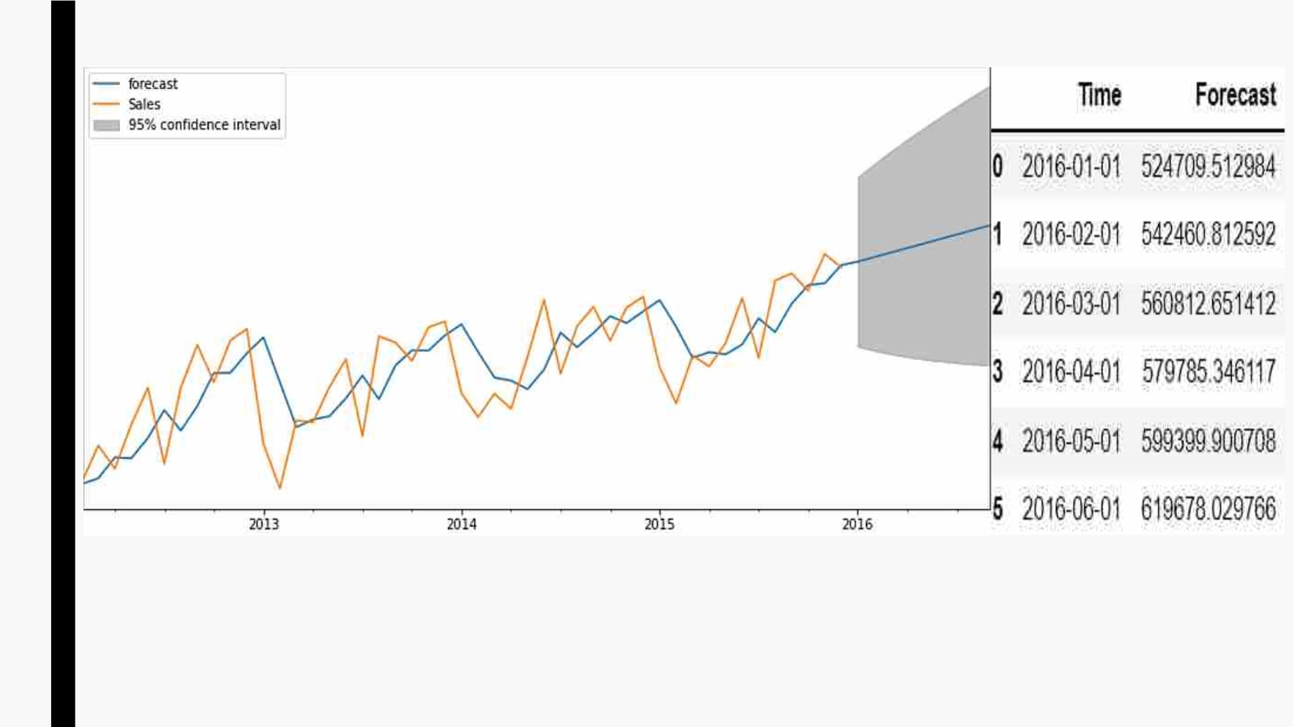
■ PlottingꢀvaluesꢀinꢀOriginalꢀScaleꢀandꢀForecastingꢀforꢀnextꢀ6ꢀmonthsꢀwithꢀMAꢀModel

Slide 36
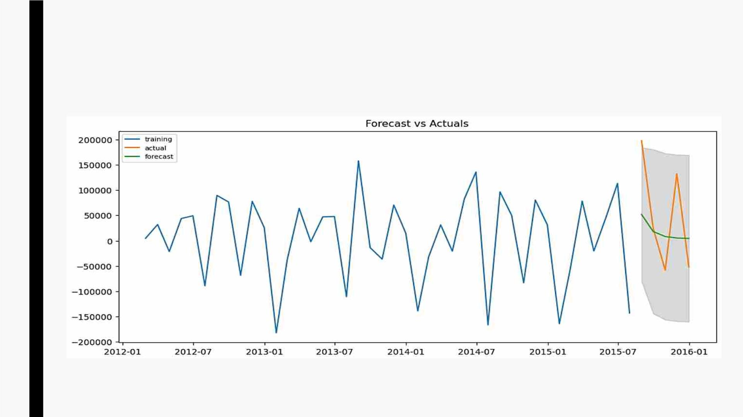
Building ARMA model
■ ARMA(AutoRegressiveꢀMovingꢀAverage)ꢀisꢀtheꢀcombinationꢀofꢀARꢀandꢀMAꢀmodels,ꢀitꢀ
takesꢀbothꢀpꢀandꢀqꢀasꢀparametersꢀwhichꢀareꢀdeterminedꢀbyꢀpacfꢀandꢀacfꢀrespectively.
■ MAPE(MeanꢀAbsoluteꢀPercentageꢀError)=0.85

Slide 37
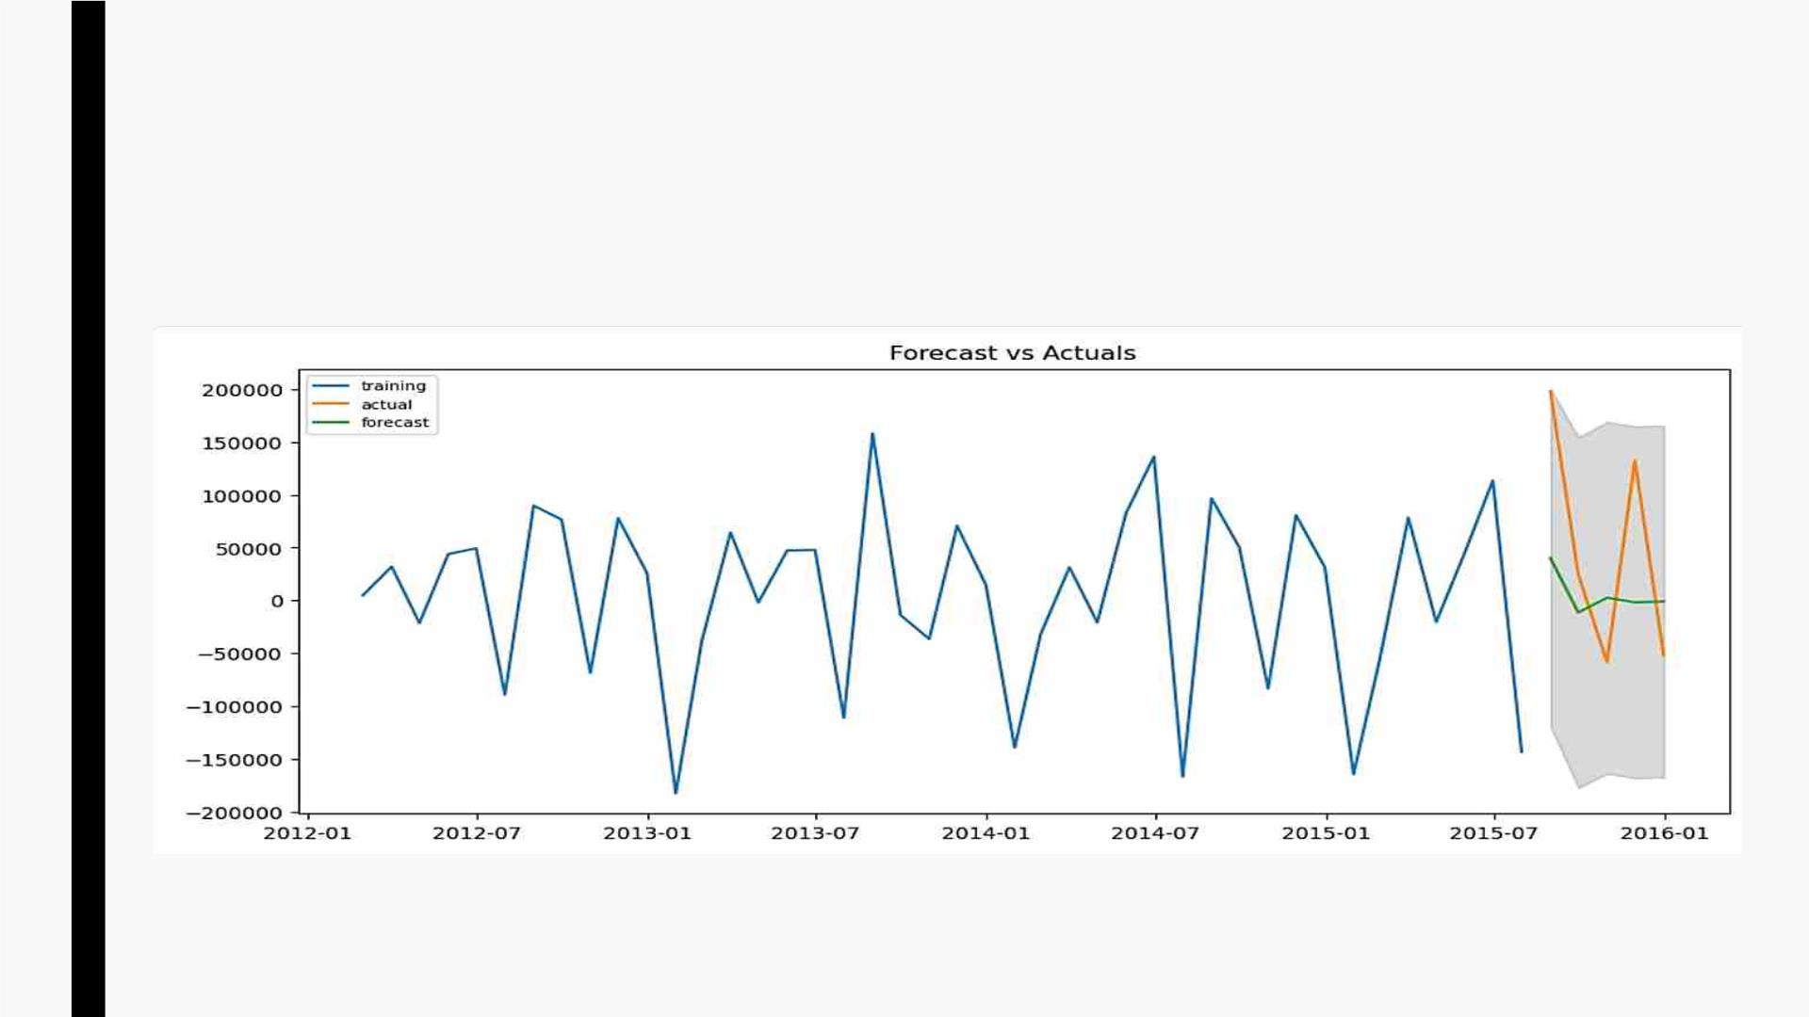
Building ARIMA model
■ ARIMA(AutoRegressiveꢀIntegratedꢀMovingꢀAverage)ꢀmodelꢀisꢀadvancedꢀformꢀofꢀ
ARMAꢀmodel,ꢀasꢀinꢀadditionꢀtoꢀpꢀandꢀq,ꢀitꢀtakesꢀdꢀasꢀanotherꢀparameterꢀinꢀcaseꢀofꢀ
differencedꢀtimeꢀseries.
■ MAPE(MeanꢀAbsoluteꢀPercentageꢀError)=1.06

Slide 38
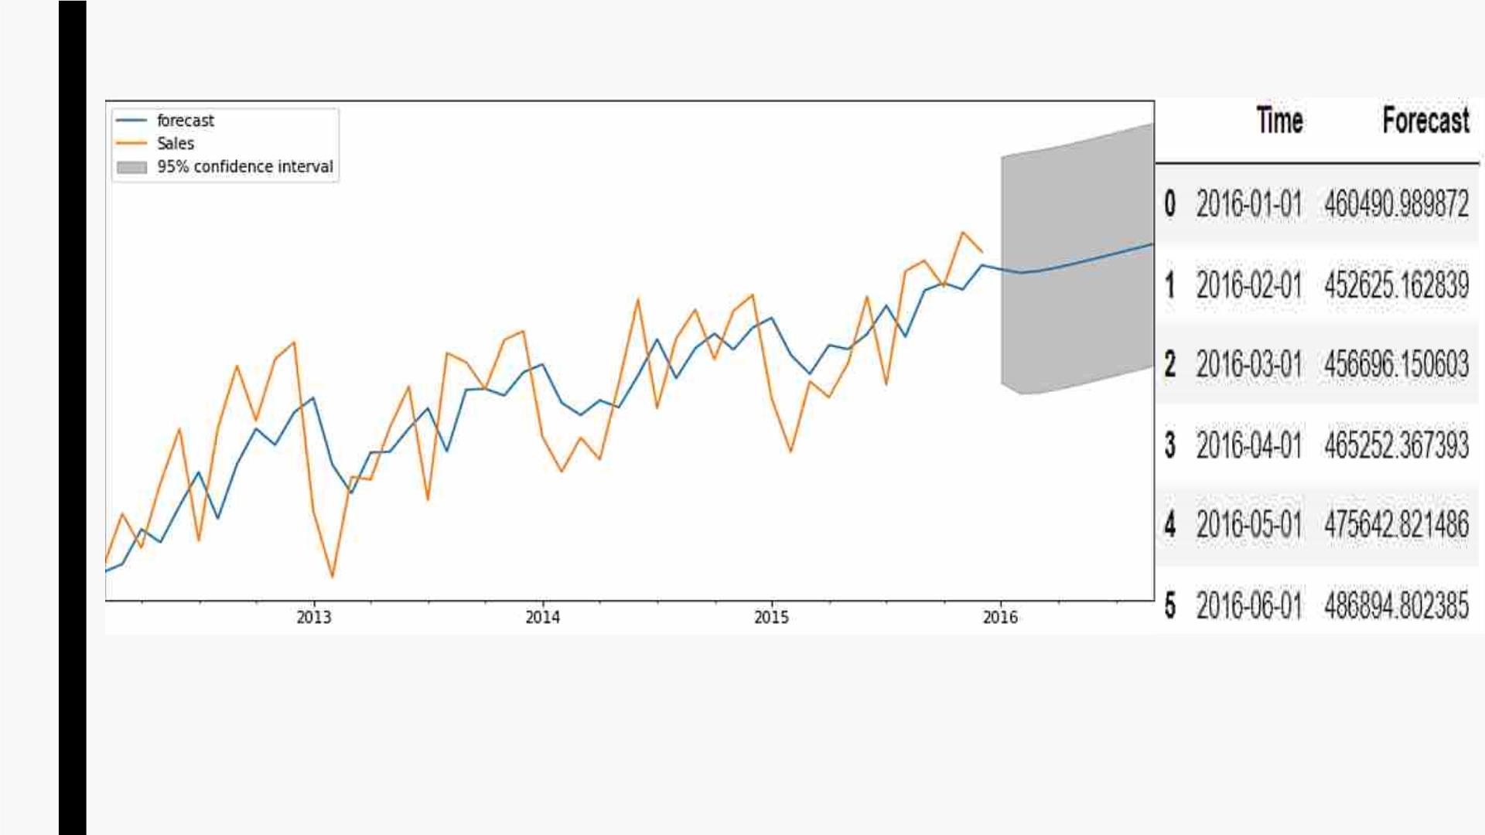
■ PlottingꢀvaluesꢀinꢀOriginalꢀScaleꢀandꢀForecastingꢀforꢀnextꢀ6ꢀmonthsꢀwithꢀARIMAꢀModel

Slide 39
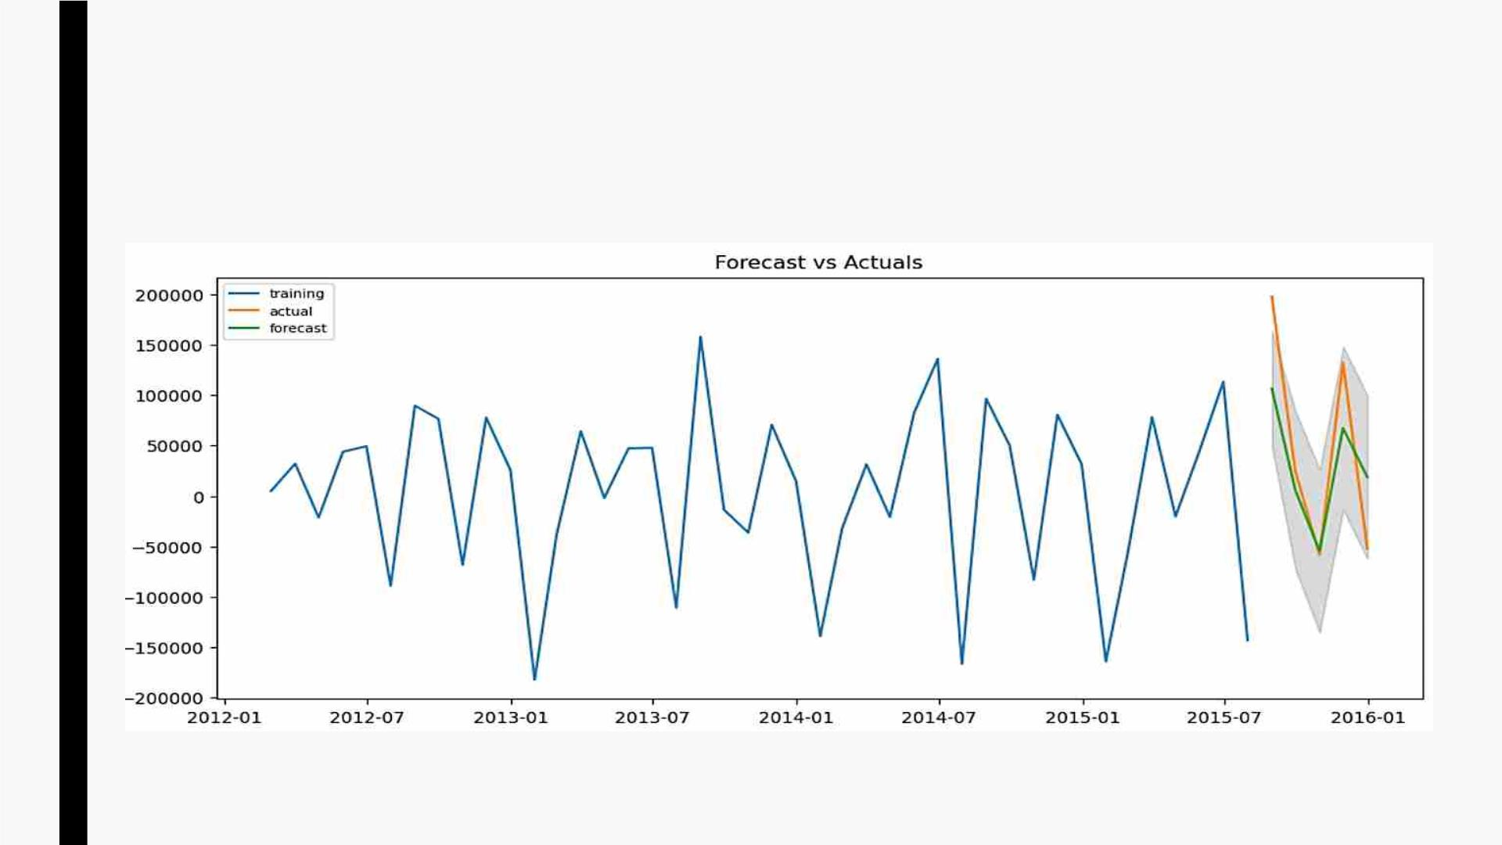
Building Auto ARIMA model
§ Inꢀ Autoꢀ ARIMA,ꢀ theꢀ modelꢀ itselfꢀ willꢀ generateꢀtheꢀ optimalꢀ p,ꢀ d,ꢀ andꢀ qꢀ valuesꢀ whichꢀ
wouldꢀbeꢀsuitableꢀforꢀtheꢀdataꢀsetꢀtoꢀprovideꢀbetterꢀforecasting.
§ MAPE(MeanꢀAbsoluteꢀPercentageꢀError)=0.63

Slide 40
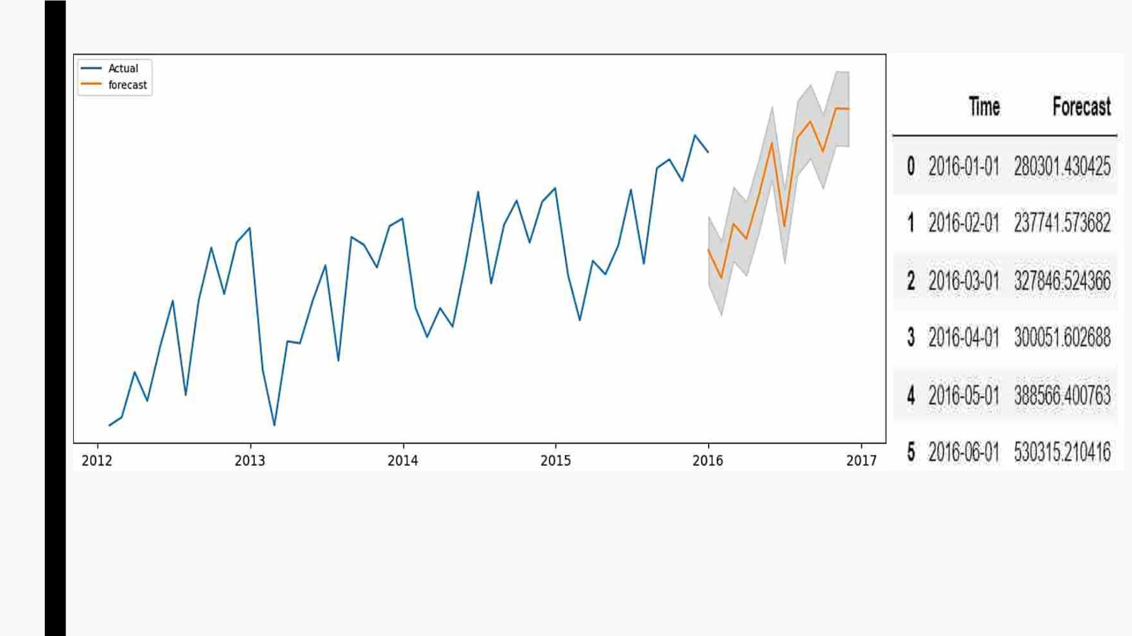
■ PlottingꢀvaluesꢀinꢀOriginalꢀScaleꢀandꢀForecastingꢀforꢀnextꢀ6ꢀmonthsꢀwithꢀAutoꢀARIMAꢀModel

Slide 41
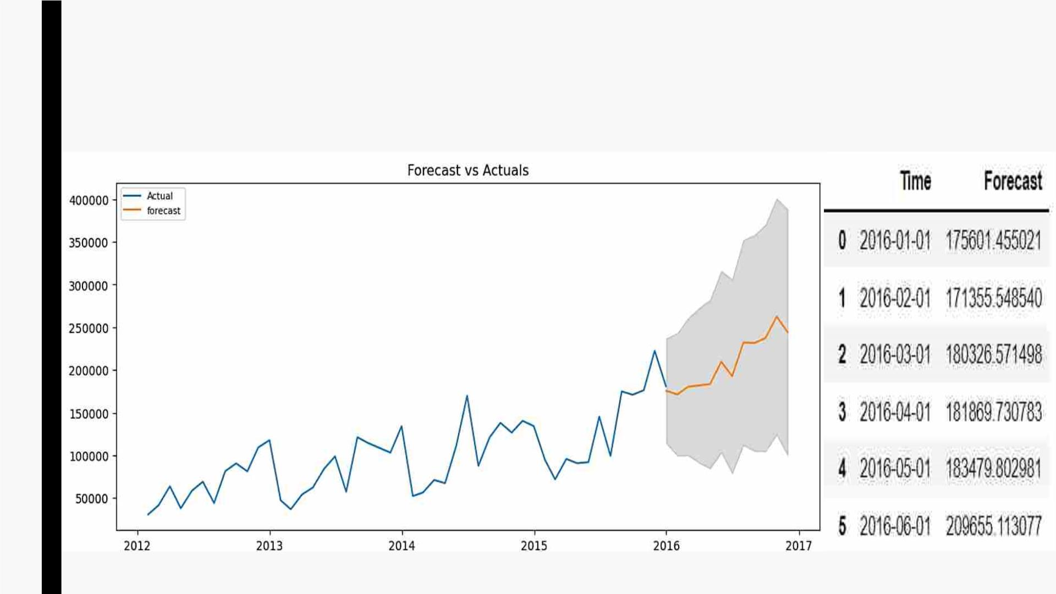
■ BasedꢀonꢀMAPEꢀandꢀPredictions,ꢀAutoꢀARIMAꢀperformsꢀcomparativelyꢀbetter,ꢀhenceꢀ
weꢀwillꢀproceedꢀwithꢀAutoꢀARIMAꢀtoꢀforecastꢀSalesꢀforꢀeachꢀCategory
■ ForecastingꢀforꢀTechnologyꢀwithꢀ95%ꢀconfidenceꢀinterval

Slide 42
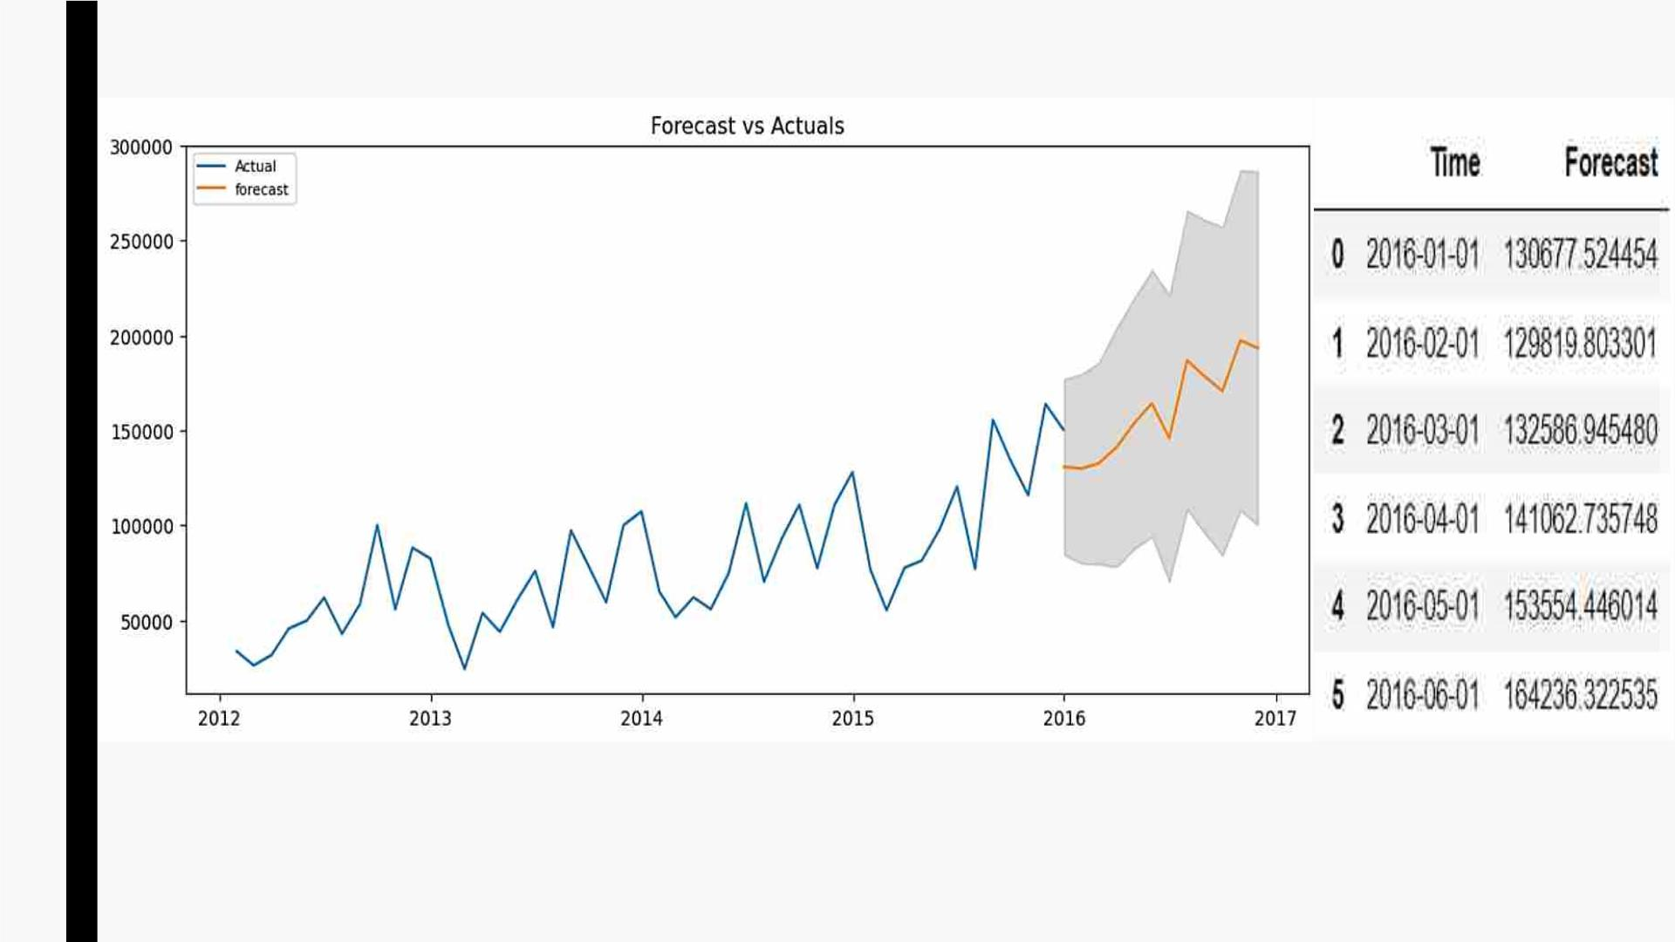
■ ForecastingꢀforꢀOfficeꢀSuppliesꢀwithꢀ95%ꢀconfidenceꢀinterval

Slide 43
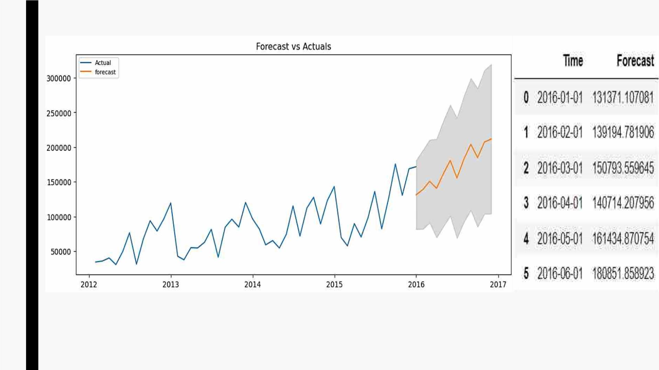
■ ForecastingꢀforꢀFurnitureꢀwithꢀ95%ꢀconfidenceꢀinterval

Slide 44

THANK YOU!

